Slide 1
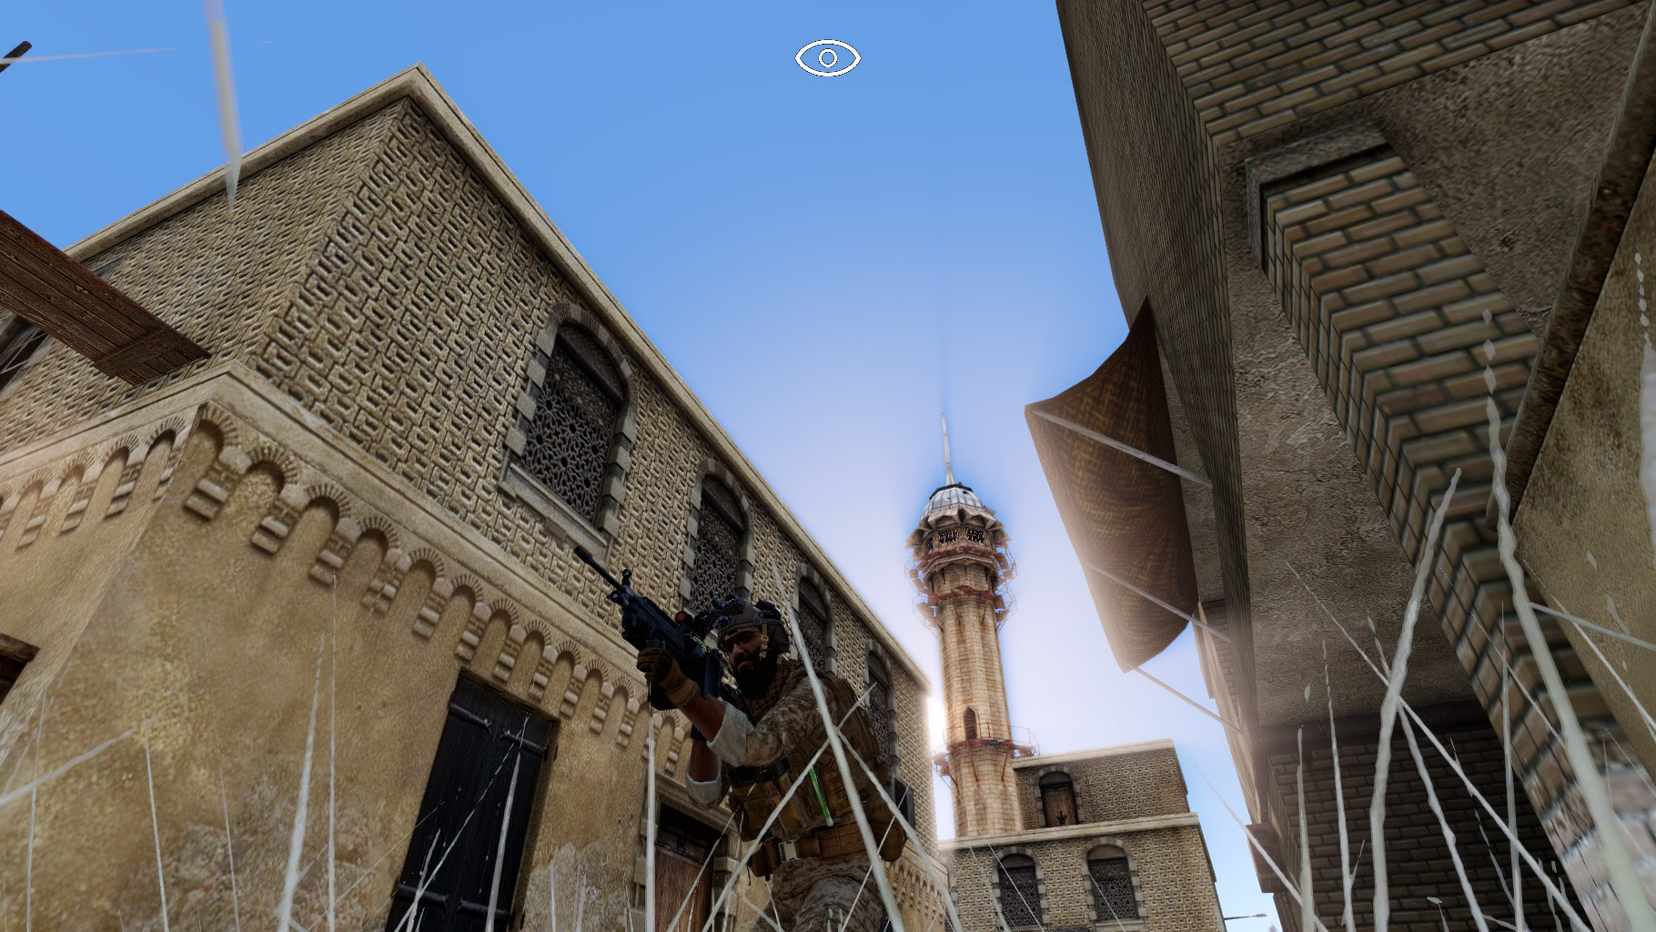













Operation Royal Alliance [SP / COOP] Dynamic Tasks [CUP - RACS]
PORTO

Slide 2
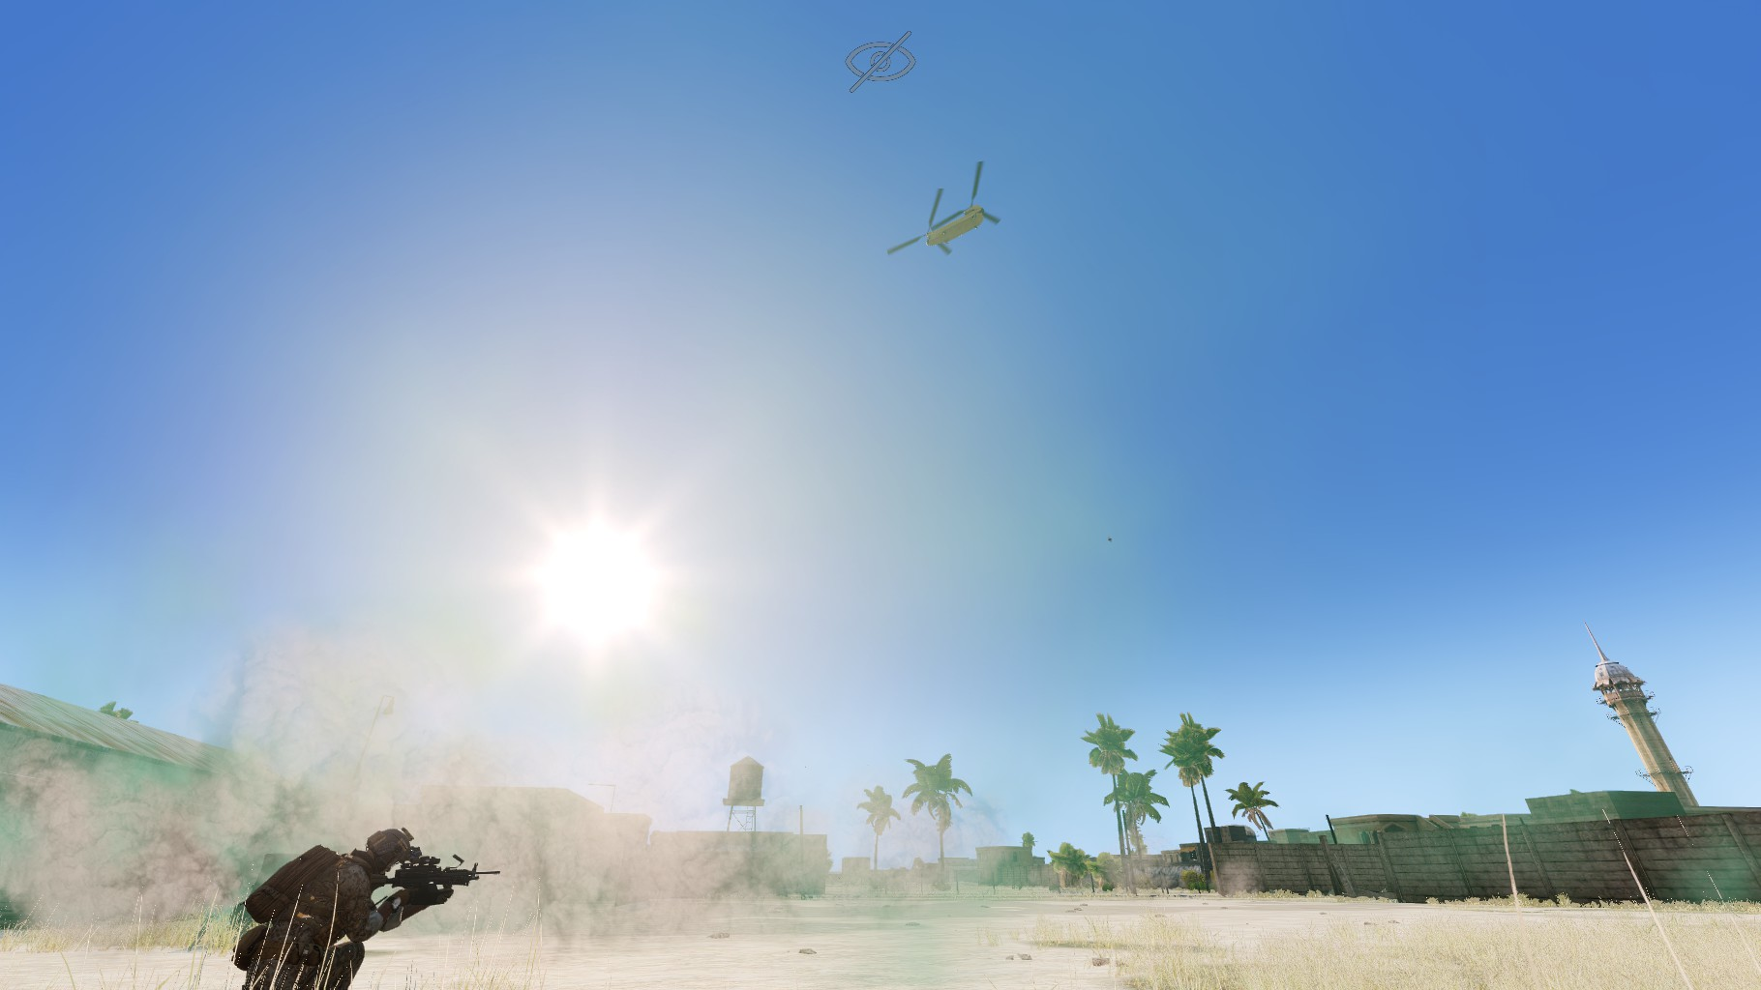
Operation Royal Alliance [SP / COOP] Dynamic Tasks [CUP - RACS]
Support Options
MQ-9 Reaper Drone : 15-minute aerial surveillance that marks allies
(blue) and enemies (red) on the map
CH-47F Chinook Helicopter :
Ammo resupply
Vehicle replacement delivery (one-time use).
Close Air Support (CAS) strike. with a 5-minute cooldown.
Squad reinforcements deployment.
Emergency team extraction.

Slide 3
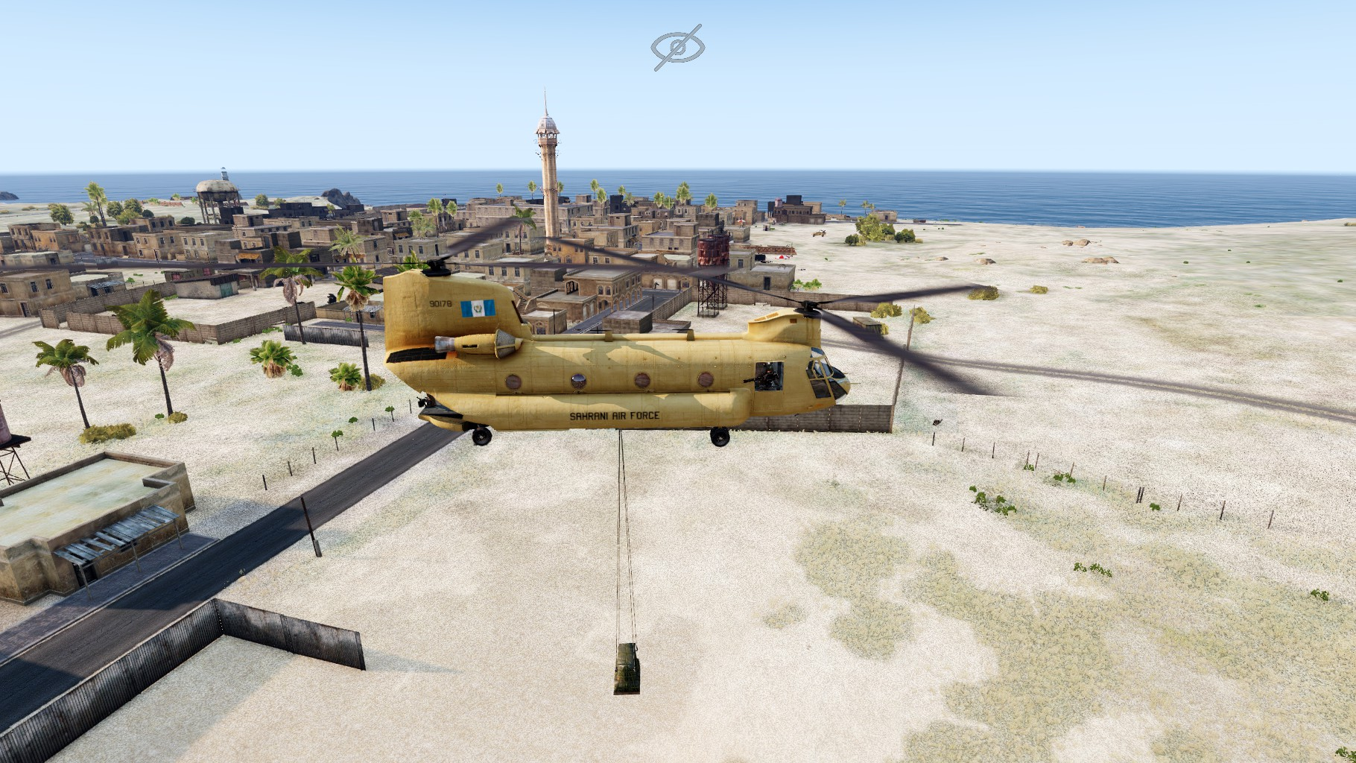
Operation Royal Alliance [SP / COOP] Dynamic Tasks [CUP - RACS]

Slide 4
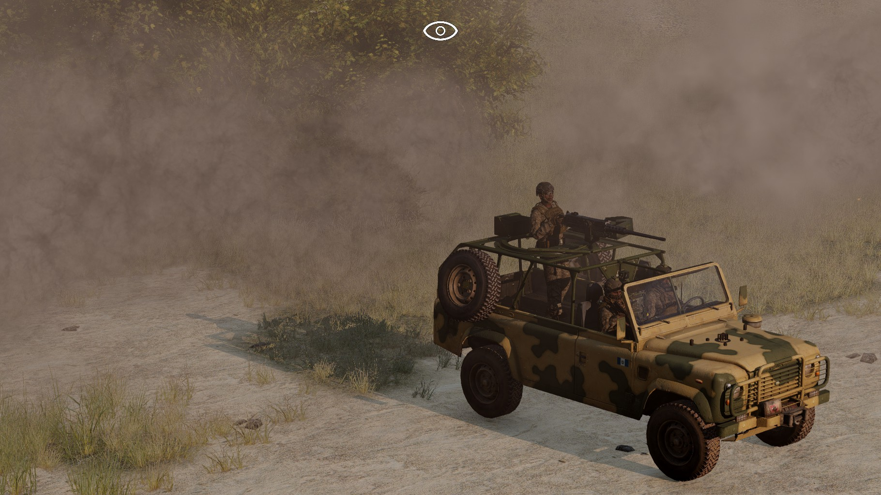
Operation Royal Alliance [SP / COOP] Dynamic Tasks [CUP - RACS]
Mechanics & Immersion
Team Switch on Death : If you die, you instantly take control of a surviving AI soldier in your squad.
Dynamic Leadership : If the squad leader is killed, command automatically transfers to the next living human player.
Randomized Identities : Every soldier gets a random name, face, voice, and gear setup (uniforms, vests, helmets) at startup.
Procedural Civilians : Ambient civilians populate the area and react to the environment (collateral damage must be avoided).
Chained Task System : The mission progresses through a series of connected, randomized objectives from insertion to completion.

Slide 5
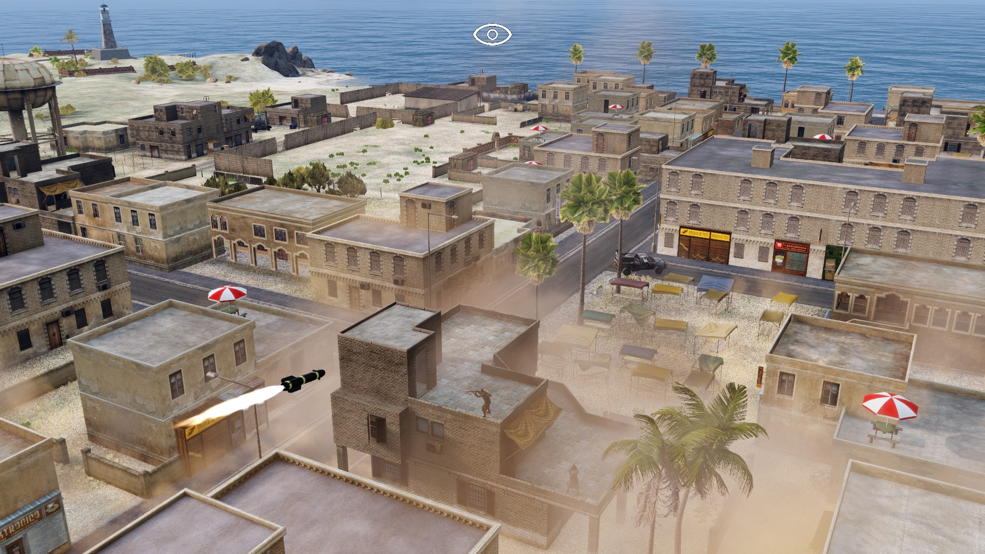
Operation Royal Alliance [SP / COOP] Dynamic Tasks [CUP - RACS]

Slide 6
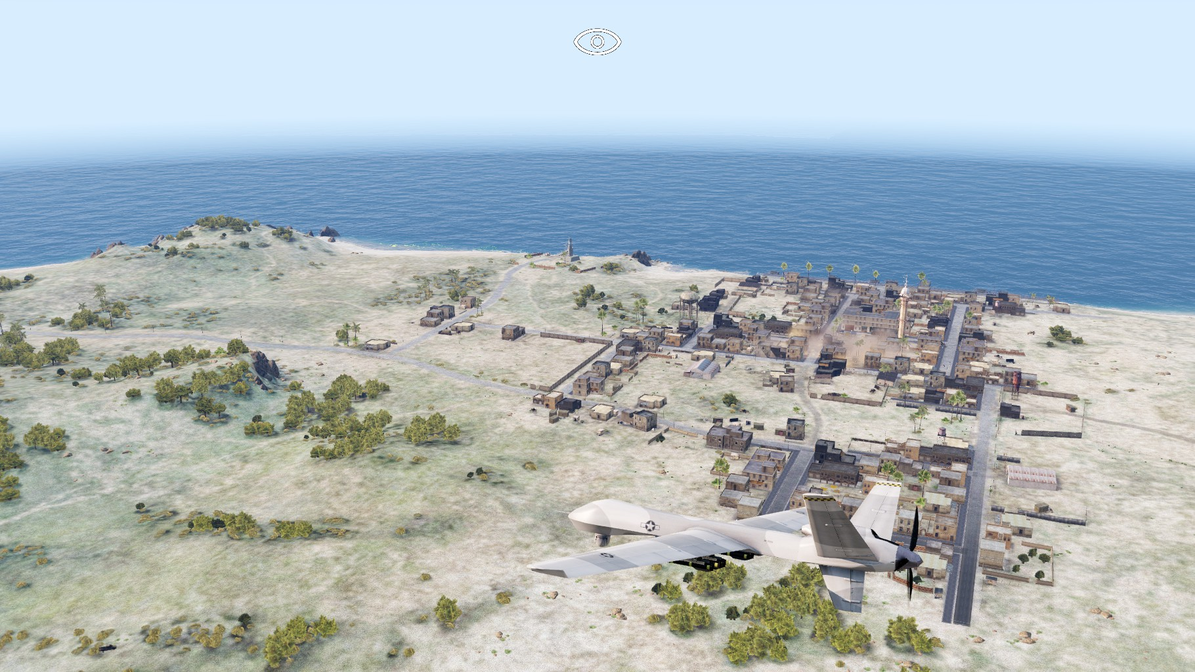
Operation Royal Alliance [SP / COOP] Dynamic Tasks [CUP - RACS]
Squad Command (AI)
4 Rules of Engagement (RoE) : Infiltration (stealth), Vigilance (default), Assault (offensive), and Charge (full sprint).
Smart Healing : Order wounded AI units to patch themselves up if they have a medical kit.
Building Search : Order AI units to clear and secure nearby building interiors within a 50m radius for 3 minutes.
Instant Regroup : Recall all scattered AI units to the leader's position immediately.

